Slide 1


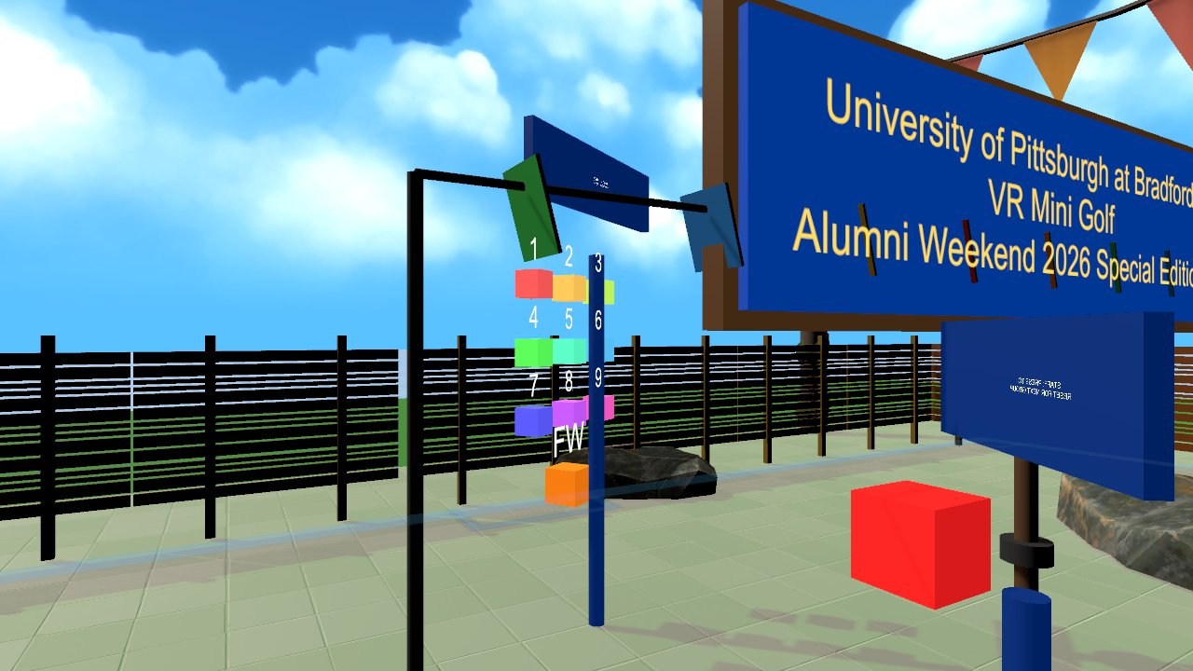

Virtual Reality
Midterm prototype: show a working VR, AR or WebXR build and its design log
Wednesdays at 6:00pm
CIST 1423 - 2010 VIRTUAL REALITY PROGRAMMING AND TECHNOLOGY
No new reading: review of Ch. 1–4, then prototype demos
Notes:
Syllabus Week 8. Title image: GolfVR's hole-select test panel, a good example of building testing tools into a prototype.

Slide 2



Agenda
Review Ch. 1–4
Prototype demos
Design log
Scenes, VR, AR, and our WebXR detour
5 minutes each, live in the lab
What a good Markdown log looks like

Slide 3

Today
By the end of class you can…
Present a working prototype in 5 minutes with a clear core loop
Tonight's plan
1
0–10
Review Ch. 1–4
Keep a design log with dated entries, screenshots and honest "what broke" notes
2
10–20
Demo format + design log
20–135
Prototype demos (5 min each)
Give and take structured feedback
3
135–145
Peer feedback
145–150
Exit ticket
CIST 1423 — Week 8 — Midterm Project Prototype

Slide 4



Review: what you can build now
Your prototype should combine at least one item from each column.
Scene building (Ch. 1–2)
Interaction (Ch. 3)
AR or WebXR (Ch. 4 + Week 7)
Primitives, prefabs, Asset Store
Materials, colliders, lighting
Clean Hierarchy
SteamVR Player, teleport, grab/throw
HoverButton, actions not raw buttons
Haptics
AR Foundation placed object, or
WebXR fork with its own parts/objects
Or: VR only, with a stronger interaction
CIST 1423 — Week 8 — Midterm Project Prototype

Slide 5

Your 5-minute demo
Same shape for everyone, so we can compare fairly.
0:00 Pitch
0:30 Live demo
2:30 How it's built
3:30 What broke
4:30 Next
One sentence: who is it for and what do they do?
Headset on (or phone/browser). Show the core loop working once, end to end.
One screenshot of the Hierarchy or code you're proud of.
One bug you hit and how you found it.
What the final project adds.
Always bring a backup video
Headsets die, Wi-Fi drops, SteamVR updates at the worst moment. A 30-second screen recording saves the demo.
CIST 1423 — Week 8 — Midterm Project Prototype

Slide 6


The design log (Markdown)
Push this as DESIGN-LOG.md next to your project.
# <Project name>: design log
## Concept
Who it's for, what they do, why VR/AR/web.
## Platform & setup
Unity 2022.3 + SteamVR 2.8 | AR Foundation | WebXR fork of ...
## Entries (newest first)
### 2026-10-14
- Built: teleport + grab test scene
- Problem: labels rendered mirrored
- Fix: TextMesh reads from -Z; removed the 180° turn
- Screenshot: docs/2026-10-14.png
## Playtest notes
## What I'd change
Good example
GolfVR Docs/README.md: controls, features, every bug found and fixed, test tools
Graded on
Working prototype on GitHub
Log with dated entries + screenshots
Honest "what broke" section
CIST 1423 — Week 8 — Midterm Project Prototype

Slide 7
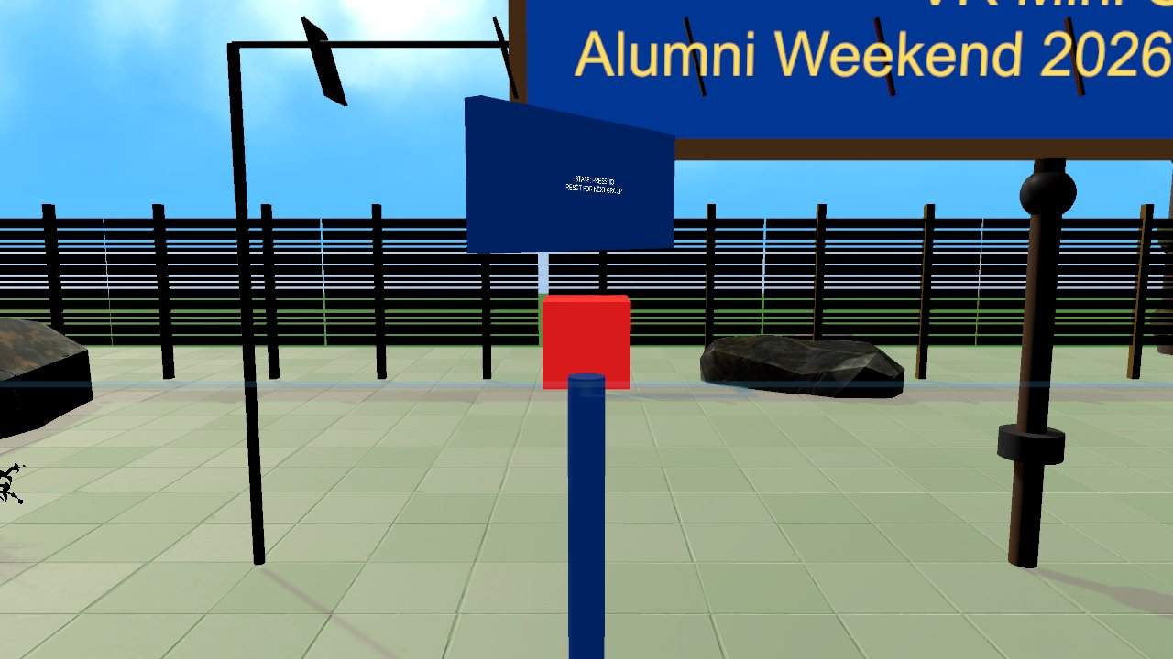
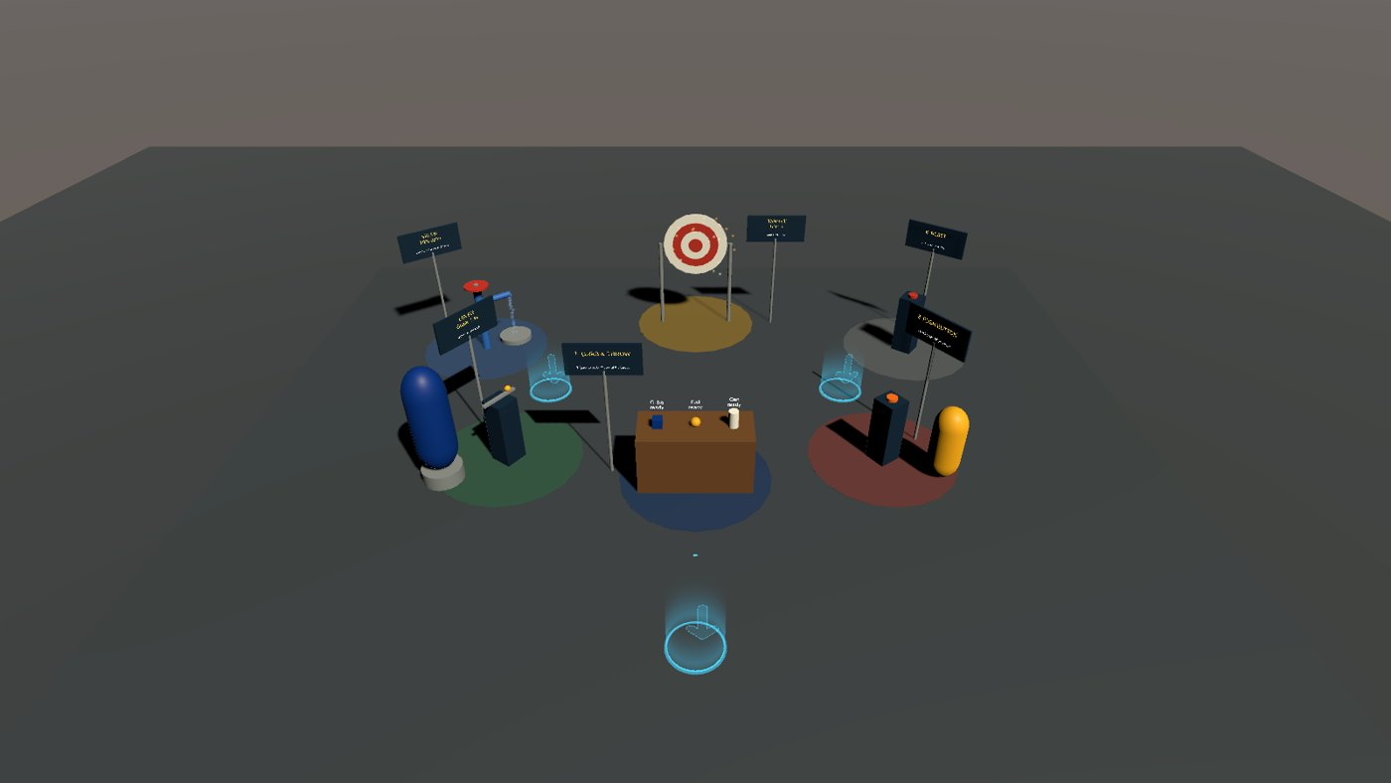
Build testing tools into your prototype
GolfVR shipped with in-world tools that made demos and testing faster.
"Pick a hole" panel: jump straight to the part you're testing
Staff reset kiosk: reset between visitors without taking off the headset
Lab 5 builder: rebuild the whole test scene from a menu command
CIST 1423 — Week 8 — Midterm Project Prototype

Slide 8
Check your understanding
Answer with a partner first, then we'll compare.
Q1
Q2
Q3
What should your first 30 seconds say?
What's the point of a backup video?
What makes a design-log entry useful later?
CIST 1423 — Week 8 — Midterm Project Prototype
Notes:
Answers:
Q1. What should your first 30 seconds say?
Who it's for and what they do: a one-sentence pitch.
Q2. What's the point of a backup video?
Hardware fails; the demo still happens.
Q3. What makes a design-log entry useful later?
A date, what was built, the problem, the fix, and a screenshot.

Slide 9

Next steps: homework + planning
Submit your midterm prototype on GitHub with DESIGN-LOG.md
Demo in class: 5 minutes, live, with a backup video
Next week: Ch. 5, interactive VR with and without code
CIST 1423 — Week 8 — Midterm Project Prototype

